Slide 1

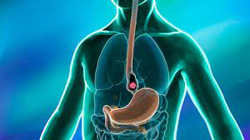
Machine Learning to diagnose Oesophageal Cancer
Project 4 group:
Robert Franklin
Brianna O’Connor
Marisa Duong
21 March 2023
Notes:
MARISA

Slide 2
Table of contents
01 | Introduction | 3
02 | Data workflow | 5
03 | Our ML models | 14
04 | Front end: Streamlit | 21
05 | Limitations & Future Work | 23
Notes:
MARISA

Slide 3

Introduction
1
Notes:
MARISA

Slide 4
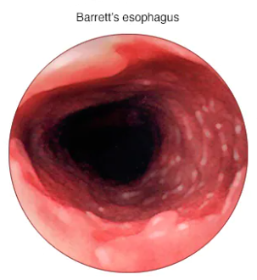
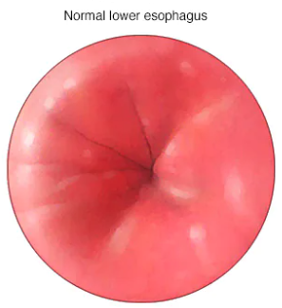
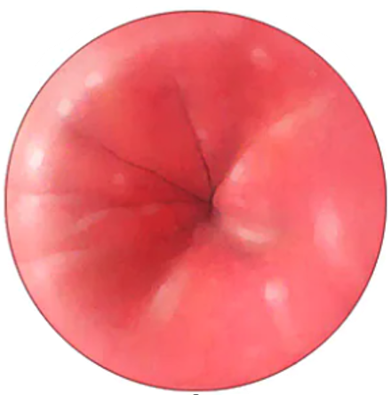
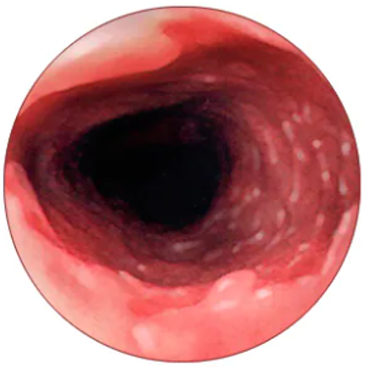
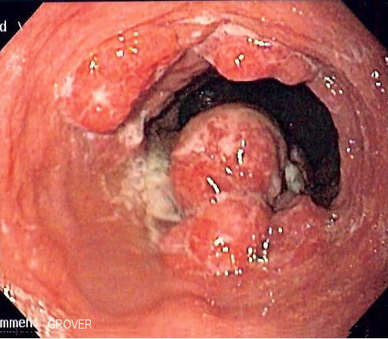
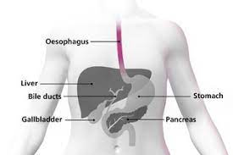
Introduction: Oesophageal cancer
Barrett’s oesophagus
Oesophageal cancer
Healthy
Goal: Build Machine Learning models
Input: clinical data (age, sex, bmi)
and wet lab data (protein levels)
Output: predict Oesophageal cancer
Notes:
MARISA

Slide 5
Data workflow
2
Notes:
MARISA

Slide 6
Approach
01
Data source and visualisations
02
ETL
03
Build ML models
04
Front-end product
03
Published peer-reviewed journal article (supplementary data)
Tableau
Extraction: csv
Transform: Python (Jupyter Notebooks), Pandas DataFrame
Load: -
Logistic regression
and supervised machine learning models
Streamlit
https://cancer-risk.streamlit.app/
Notes:
MARISA

Slide 7
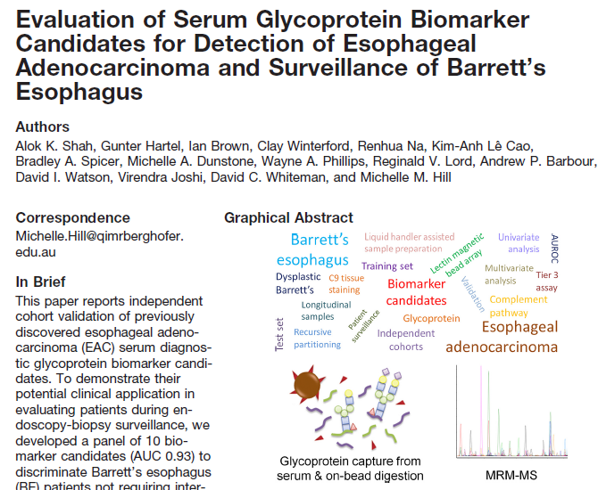
Data source
https://doi.org/10.1074/mcp.RA118.000734
Notes:
MARISA

Slide 8
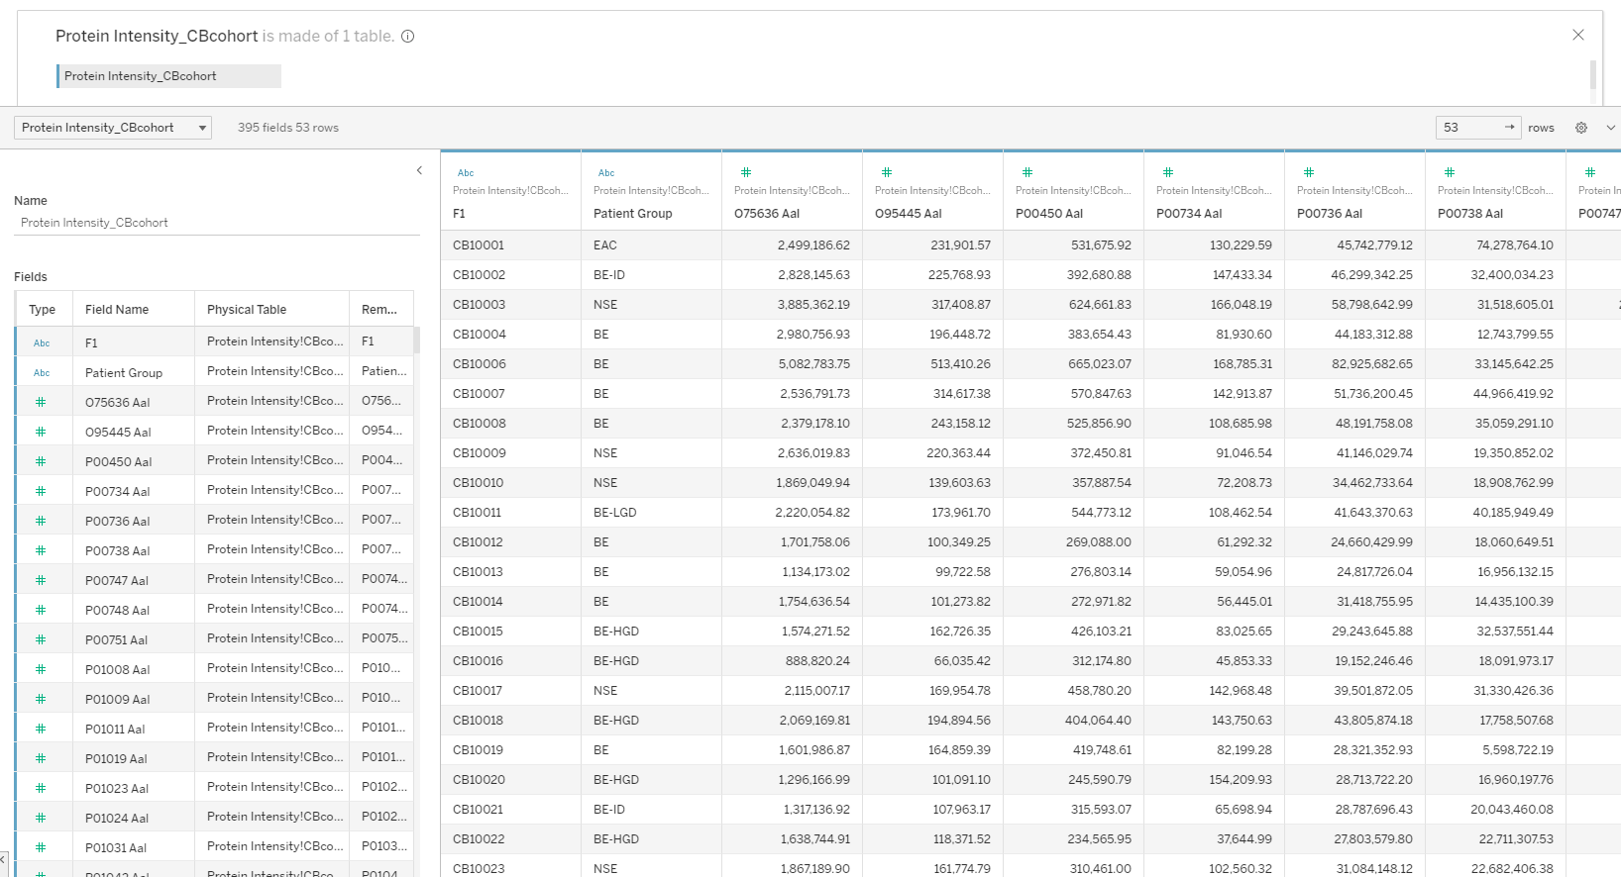
Data
Patient
Notes:
MARISA

Slide 9
Data
Patient group
Notes:
MARISA

Slide 10
Data
Wet lab protein data
Notes:
MARISA

Slide 11
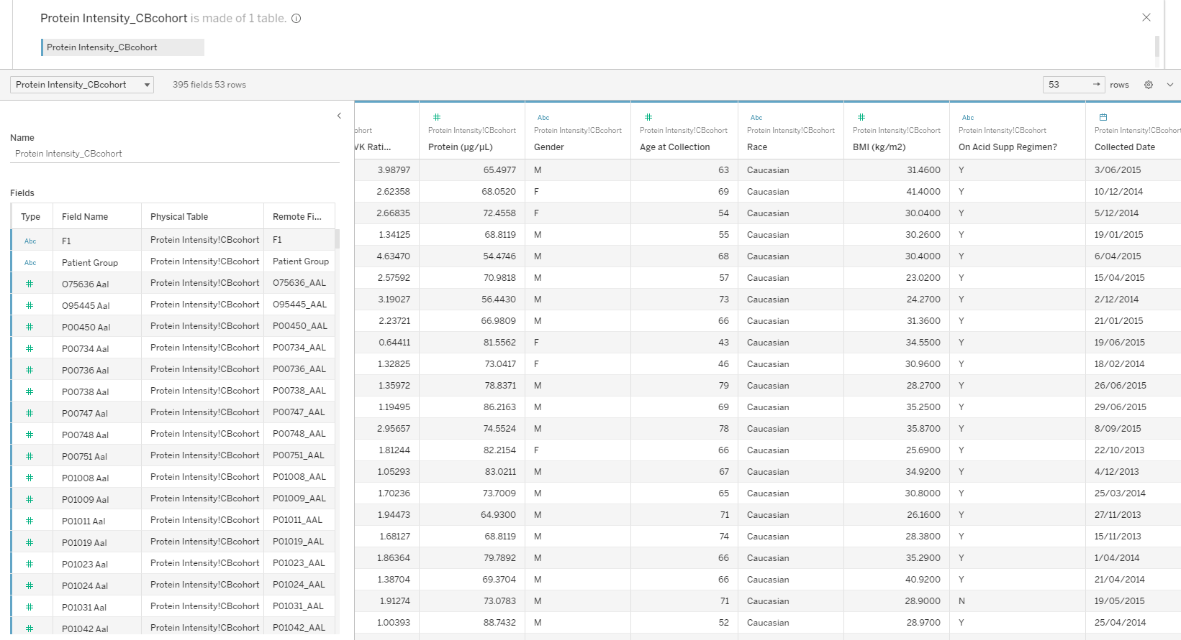
Data
Clinical data
Notes:
MARISA

Slide 12
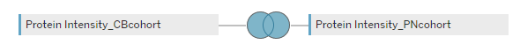
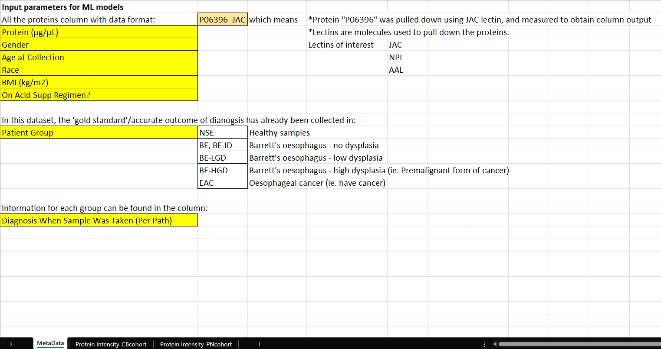
Data
53 rows
253 rows
Notes:
MARISA

Slide 13
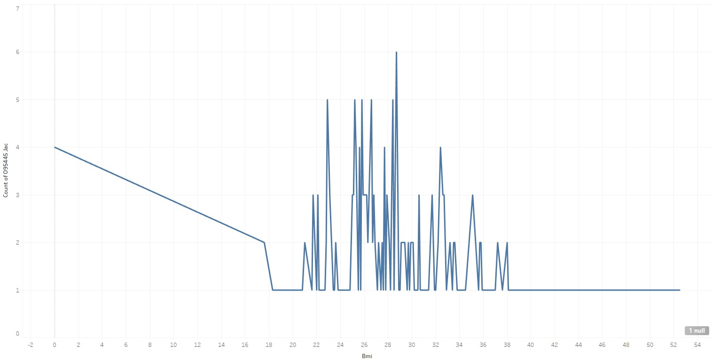
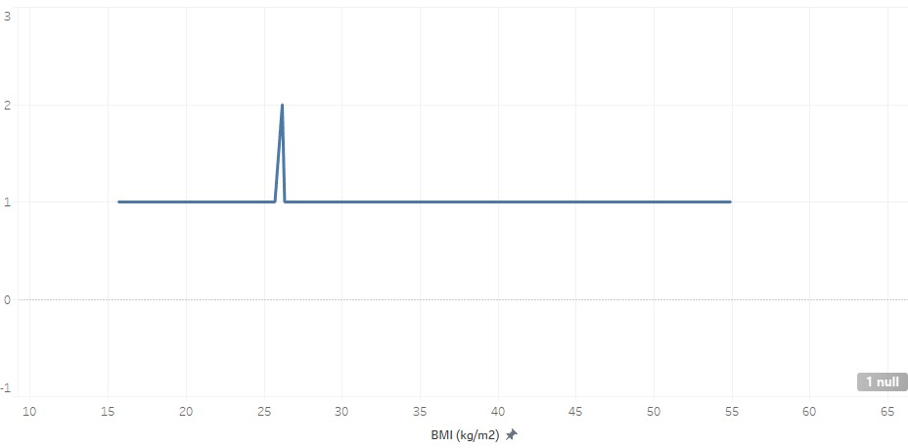
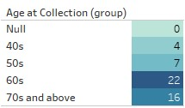
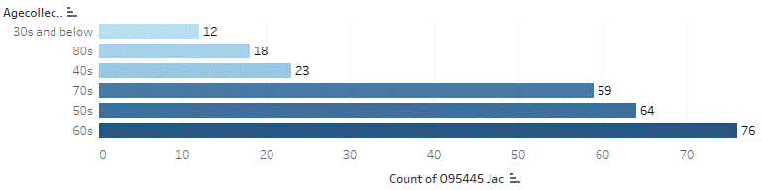
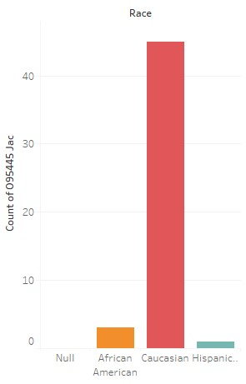
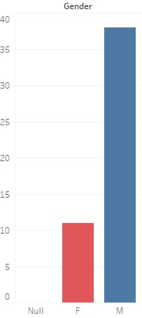
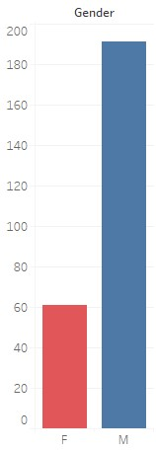
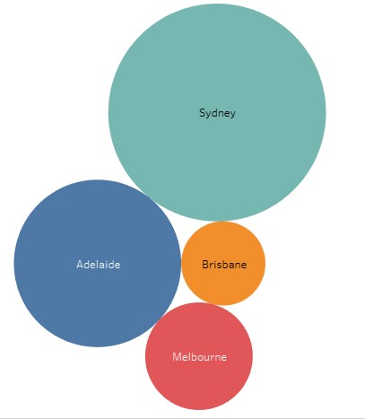
Tableau visualisations
BMI
53 rows
253 rows
BMI
Notes:
MARISA

Slide 14
Our ML models
3
Notes:
MARISA →BRIANNA

Slide 15

How do we optimise ML models?
Target selection
Data going in
Which model?
Best parameters
Notes:
BRIANNA

Slide 16
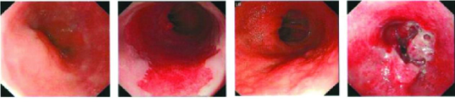
Grouping data
Barrett’s oesophagus
Oesophageal cancer
Healthy
No dysplasia
High-grade dysplasia
Low-grade dysplasia
Notes:
BRIANNA
There are multiple diagnoses in the dataset. 3 Major groups are Healthy, BE, and Cancer. BE is the only known precursor to cancer. There are different stages. Low or no dysplasia and high-grade dysplasia.
LGD is of particular interest because these patients could avoid HGD if diagnosed and treated early. Treatment for HGD is similar to treatment for Oesophageal cancer.
With this in mind, we have developed two groupings to test for.
Healthy or other
Exclude healthy, focus classifying LGD from HGD and cancer.

Slide 17
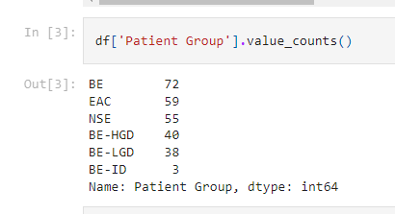
2. Data in
1. Target
There are multiple categories in the target column.
We need to group the targets to work with binary classifier models.
‘Healthy’ vs ‘the rest’
BE vs BE-HGD and cancer
There are four different presentations of this data.
All values
Clinical information only
Clinical information and protein measurements
Clinical information and protein ratios

Slide 18
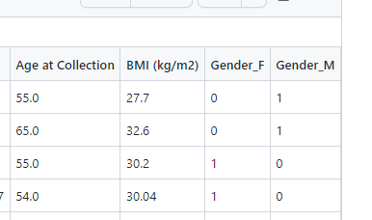
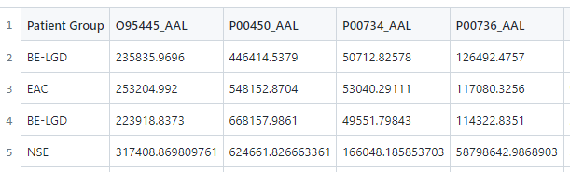
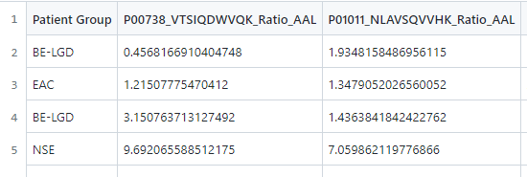
2. Data in
What information is useful?
How important is clinical data? Blood data?
Data four ways:
All values
Clinical only
Clinical + protein measurements
Clinical + protein ratios
Notes:
Brianna
Can we make predictions without blood data at all?
Wet lab data has measurement and ratio values for each protein
We don’t know how the ratio value was generated, which means we don’t know if both hospitals followed the same formula. = Test without ratio values
We don’t know why they created ratio values. There must be a reason = Test with ratio values instead of measurements

Slide 19

3. Model selection
Logistic Regression
Decision Tree
Random Forest
Support Vector Machine
Supervised ML
Classification models
Notes:
Brianna
Supervised ML was the obvious choice because we know which clusters to look for.
Settled on four classification models to try.

Slide 20
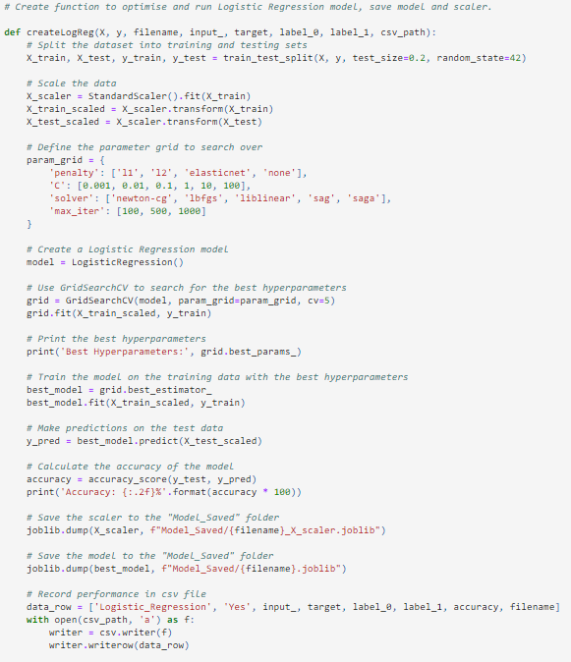
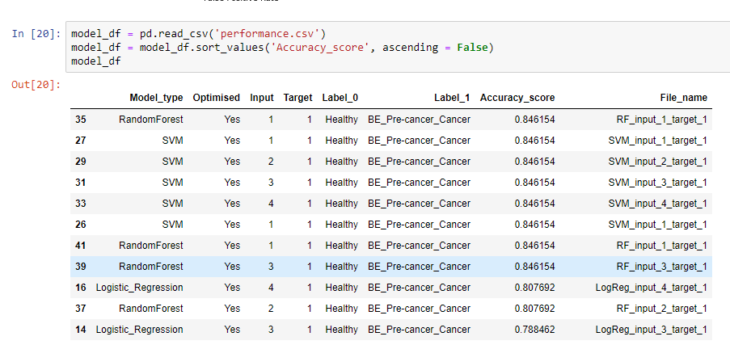
4. Best Parameters
Use Grid Search to find best parameters for each model
Notes:
Brianna
Create function for each model type and use grid search to find best parameters.
Function saves the model, scaler and records performance in csv file.
Explored Logistic Regression, Decision Trees, Random Forest and SVM.
Create each model with parameter optimisation
Run each model with 4 inputs and test for 2 targets = 8 instances per model
Logistic Regression was also run without parameter optimisation for comparison

Slide 21
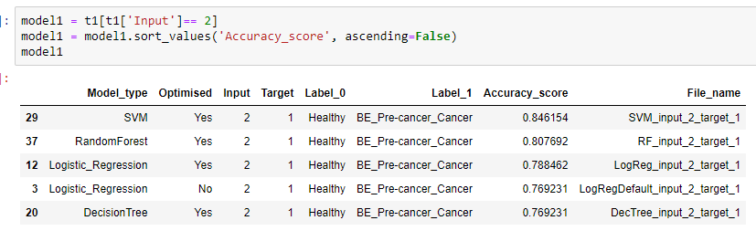
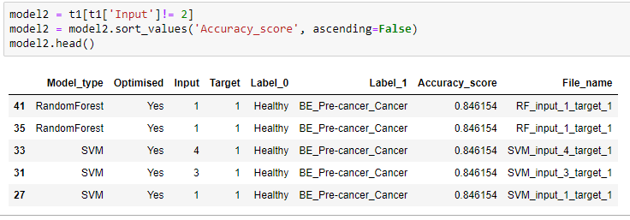
The process
Target - two tests
Data – four subsets
Which Model?
Parameters
Healthy vs the rest
BE low vs BE high & cancer
All columns
Clinical only
Clinical & protein measurements
Clinical & protein ratios
Logistic Regression
Decision Tree
Random Forests
SVM
Optimise using Grid Search

Slide 22

Test 1: Healthy vs BE & Cancer
Test 2: BE vs BE-HGD & Cancer
Model 1
Model 3
No blood data
With blood
Model 2
Model 4

Slide 23
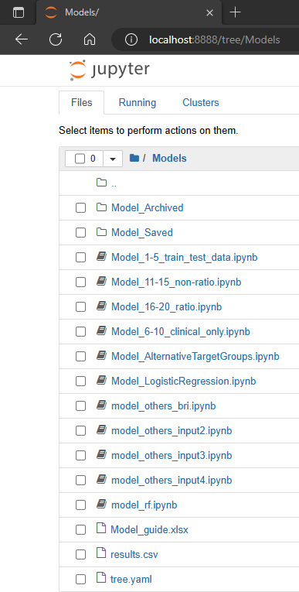
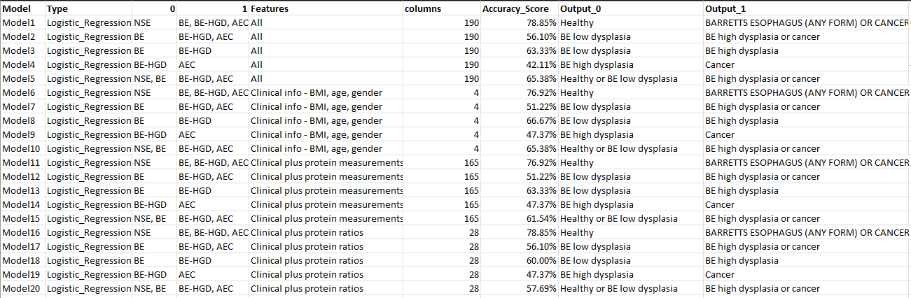
Supervised machine learning
Model guide:
Notes:
BRIANNA

Slide 24
3. Find the best parameters
Explored Logistic Regression, Decision Trees, Random Forest and SVM.
Create each model with parameter optimisation
Run each model with 4 inputs and test for 2 targets = 8 instances per model
Logistic Regression was also run without parameter optimisation for comparison
Notes:
BRIANNA

Slide 25
Performance of ML models

Slide 26
Front end: Streamlit
4
Notes:
ROB

Slide 27
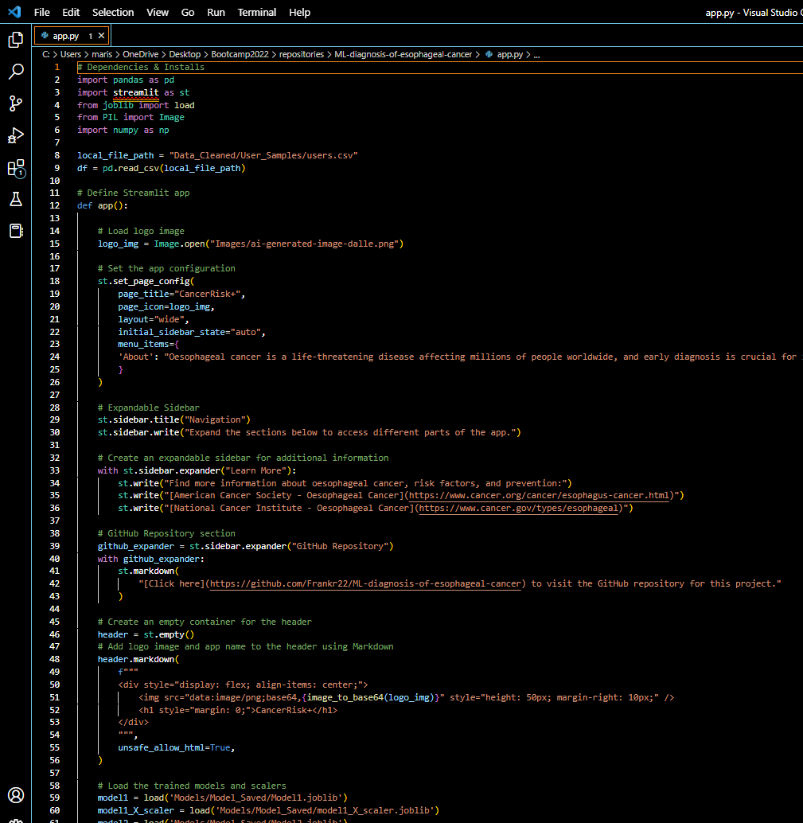
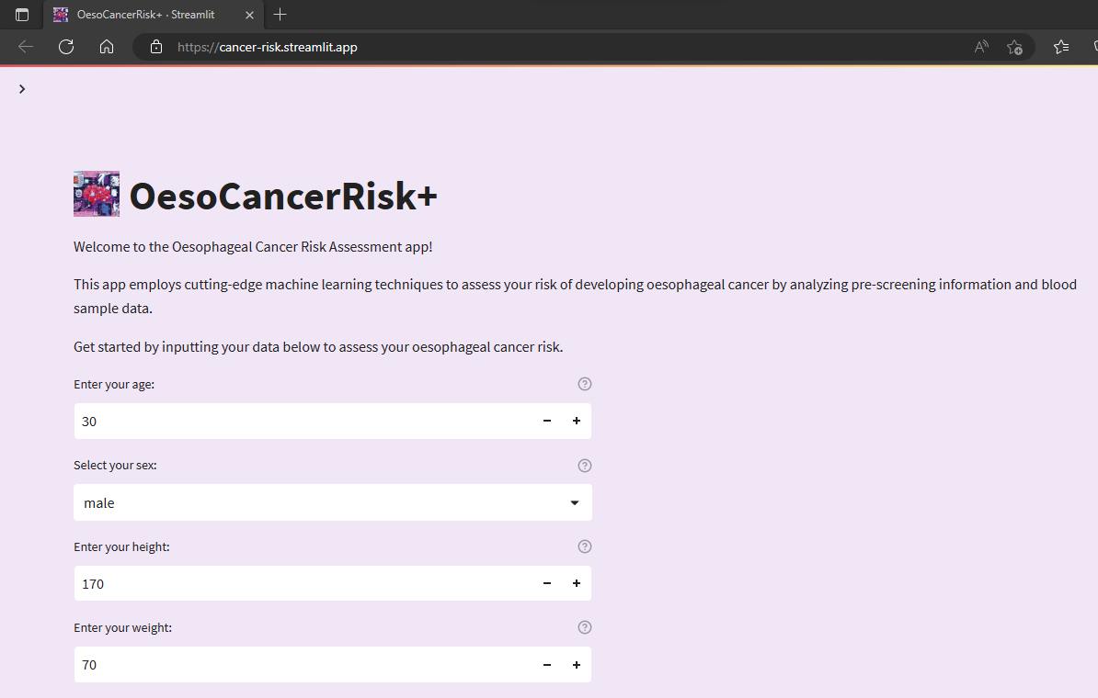
User friendly app interface to predict esophageal cancer
https://cancer-risk.streamlit.app/
Notes:
ROB

Slide 28
Limitations & Future Work
5
Notes:
ROB
Now for a look at the output - our interactive dashboard

Slide 29
Limitations
Small datasets (hundreds, US and AUS; not thousands, internationally):
49 + 252 data entries combined from 2 cohorts
– 10 samples taken out to test app
Limited age range in training model.
Need to use app with caution, talk to GP who understands the limitations of ML models.
When diagnosing cancer in Healthy individual, Barrett’s esophagus data is excluded in the ML model (ie. Assuming the person is confirmed healthy)
Future Work
Add more patients into training models
Optimise more models
Improved Data Storage
GitHub repository: https://github.com/Frankr22/ML-diagnosis-of-esophageal-cancer
Notes:
There’s opportunities for future development and expansion of this project, such as incorporating additional data sources or expanding the scope of the analysis.
For example useful mortgage delinquency data, inflation data, and other key macroeconomic housing market indicators
Improved layout css and html
Time consuming,
More interactivity
Database setup
The current setup uses SQLAlchemy as the Object Relational Mapper (ORM) to interact with a remote database hosted on Amazon Web Services (AWS). The database username and password are stored in a gitignore file (console.py) to protect sensitive information.
A simpler and more straightforward solution, would be to switch the database to a local SQLite database that is stored as a file on the user’s local machine. The SQLite database does not require a remote connection or authentication, so there is no need to store the database credentials in a separate file.
With the current setup, the database is hosted remotely on AWS and requires a connection over the internet, which can be slower and more susceptible to network issues. With the SQLite option, the database is stored locally on the user's machine, which allows for faster access times and eliminates the need for a remote connection.

Slide 30
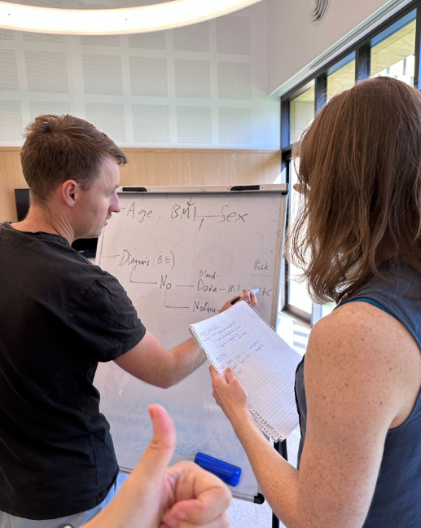
Q&A
Notes:
That’s the end of our presentation, so now we’ll open up to some questions.

